Slide 1
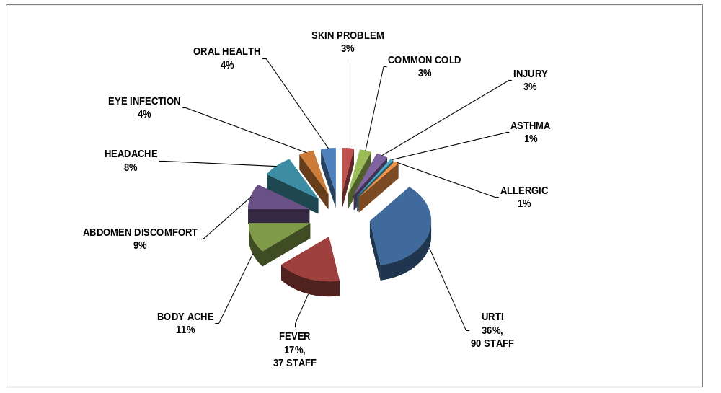
Presenter : Devi / Navin
Position : HR Officer
Page : 18 / 29
Cough, sore throat, runny nose, flu, sneezing headache & fever
Prepared by : S.Devi Verified by : Mr.Narasimman Approved by : Khor Soon Seng
Date : 04.08.2011 Date : 04.08.2011 Date : 04.08.2011

Slide 2
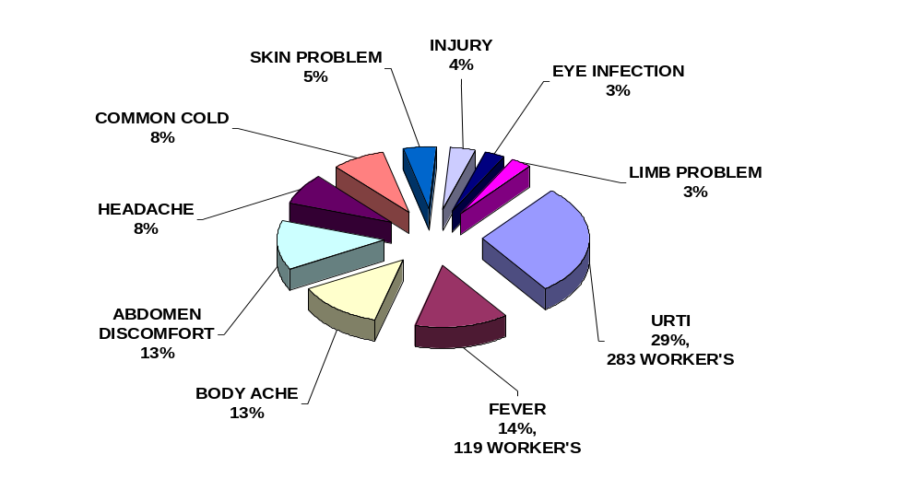
Presenter : Devi / Navin
Position : HR Officer
Page : 19 / 29
Cough, sore throat, runny nose, flu, sneezing headache & fever
Prepared by : S.Devi Verified by : Mr.Narasimman Approved by : Khor Soon Seng
Date : 04.08.2011 Date : 04.08.2011 Date : 04.08.2011

